Slide 1
Model free
Model based
Value functions
Learn value functions
Generate policy from a value function
Discrete action spaces only
Q-Learning
DQN
SOTA* = Rainbow
Policy optimization
Learn value functions
Learn a policy
Continuous and discrete action spaces
REINFORCE
A2C & A3C
TRPO
SOTA = Proximal Policy Optimization
Dynamic programming
Monte Carlo Tree Search
Learn environment model
Plan using environment model
AlphaGo
World Models
SOTA = Alpha Zero
* SOTA = state of the art

Slide 2
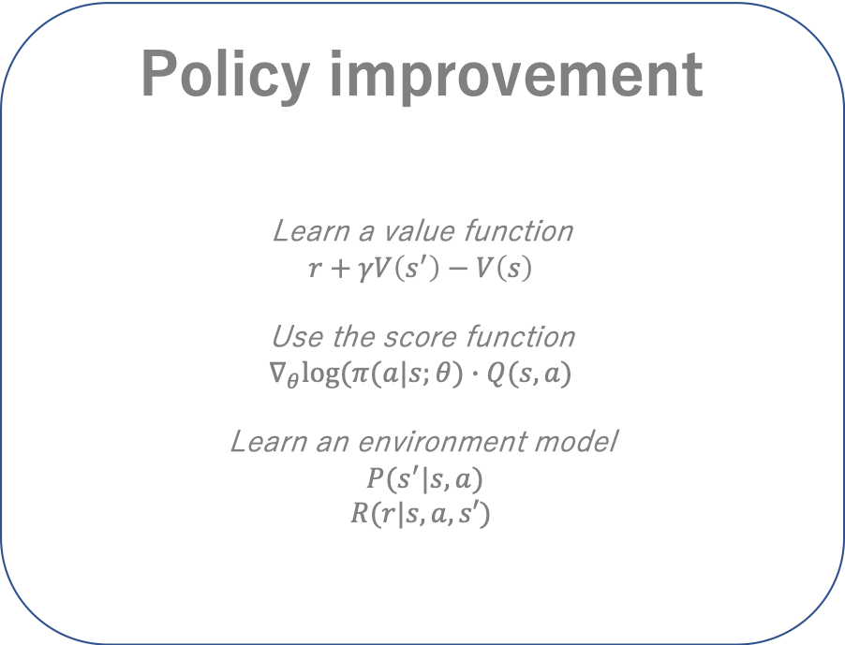
Data generation
Environment
Dataset
state, reward
action
Agent
Policy improvement
Learn a value function
$$r+γV\left(s^{′}\right)−V\left(s\right)$$
Use the score function
$$∇_{θ}log⁡(π(a|s;θ)∙Q(s,a)$$
Learn an environment model
$P(s^{′}|s,a)$
$$R(r|s,a,s′)$$
Policy

Slide 4
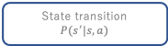
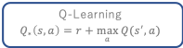
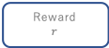

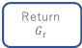
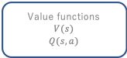
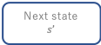
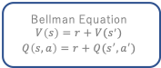
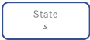

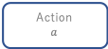
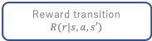
Environment
Agent
State
$$s$$
Action
$$a$$
Reward
$$r$$
Next state
$$s’$$
State transition
$$P(s^{′}|s,a)$$
Reward transition
$$R(r|s,a,s′)$$
Policy
$$π(s|a)$$
Environment model
Value functions
$$V(s)$$
$$Q(s,a)$$
Return
$$G_{t}$$
Experience
$$(s,a,r, s^{′})$$
Dynamic programming
Bellman Equation
$$V\left(s\right)=r+V(s^{′})$$
$$Q\left(s,a\right)=r+Q(s^{′},a^{′})$$
Q-Learning
$$Q_{∗}\left(s,a\right)=r+\max_{a}{Q(s^{′},a)}$$
Target networks
DQN
Experience replay
Double Q-Learning
Rainbow
n-step returns
Prioritized experience replay

